Slide 1
Parallel Programming in C with MPI and OpenMP
Michael J. Quinn

Slide 2
Chapter 1
Motivation and History

Slide 3
Outline
Motivation
Modern scientific method
Evolution of supercomputing
Modern parallel computers
Seeking concurrency
Data clustering case study
Programming parallel computers

Slide 4
Why Faster Computers?
Solve compute-intensive problems faster
  Make infeasible problems feasible
  Reduce design time
Solve larger problems in same amount of time
  Improve answer’s precision
  Reduce design time
Gain competitive advantage

Slide 5
Definitions
Parallel computing
  Using parallel computer to solve single problems faster
Parallel computer
  Multiple-processor system supporting parallel programming
Parallel programming
  Programming in a language that supports concurrency explicitly

Slide 6
Why MPI?
MPI = “Message Passing Interface”
Standard specification for message-passing libraries
Libraries available on virtually all parallel computers
Free libraries also available for networks of workstations or commodity clusters

Slide 7
Why OpenMP?
OpenMP an application programming interface (API) for shared-memory systems
Supports higher performance parallel programming of symmetrical multiprocessors

Slide 8
Classical Science
Nature
Observation
Physical
Experimentation
Theory

Slide 9
Modern Scientific Method
Nature
Observation
Numerical
Simulation
Physical
Experimentation
Theory

Slide 10
Evolution of Supercomputing
World War II
  Hand-computed artillery tables
  Need to speed computations
  ENIAC
Cold War
  Nuclear weapon design
  Intelligence gathering
  Code-breaking

Slide 11
Supercomputer
General-purpose computer
Solves individual problems at high speeds, compared with contemporary systems
Typically costs $10 million or more
Traditionally found in government labs

Slide 12
Commercial Supercomputing
Started in capital-intensive industries
  Petroleum exploration
  Automobile manufacturing
Other companies followed suit
  Pharmaceutical design
  Consumer products

Slide 13

50 Years of Speed Increases
Today
> 1 trillion flops
One Billion Times Faster!
ENIAC
350 flops

Slide 14
CPUs 1 Million Times Faster
Faster clock speeds
Greater system concurrency
  Multiple functional units
  Concurrent instruction execution
  Speculative instruction execution

Slide 15
Systems 1 Billion Times Faster
Processors are 1 million times faster
Combine thousands of processors
Parallel computer
  Multiple processors
  Supports parallel programming
Parallel computing = Using a parallel computer to execute a program faster

Slide 16
Microprocessor Revolution
Speed (log scale)
Micros
Supercomputers
Moore's Law
Mainframes
Minis
Time

Slide 17
Modern Parallel Computers
Caltech’s Cosmic Cube (Seitz and Fox)
Commercial copy-cats
  nCUBE Corporation
  Intel’s Supercomputer Systems Division
  Lots more
Thinking Machines Corporation

Slide 18
Copy-cat Strategy
Microprocessor
  1% speed of supercomputer
  0.1% cost of supercomputer
Parallel computer = 1000 microprocessors
  10 x speed of supercomputer
  Same cost as supercomputer

Slide 19
Why Didn’t Everybody Buy One?
Supercomputer ≠ Σ CPUs
  Computation rate ≠ throughput
  Inadequate I/O
Software
  Inadequate operating systems
  Inadequate programming environments

Slide 20
After the “Shake Out”
IBM
Hewlett-Packard
Silicon Graphics
Sun Microsystems

Slide 21
Commercial Parallel Systems
Relatively costly per processor
Primitive programming environments
Focus on commercial sales
Scientists looked for alternative

Slide 22
Beowulf Concept
NASA (Sterling and Becker)
Commodity processors
Commodity interconnect
Linux operating system
Message Passing Interface (MPI) library
High performance/$ for certain applications

Slide 23
Advanced Strategic Computing Initiative
U.S. nuclear policy changes
  Moratorium on testing
  Production of new weapons halted
Numerical simulations needed to maintain existing stockpile
Five supercomputers costing up to $100 million each

Slide 24
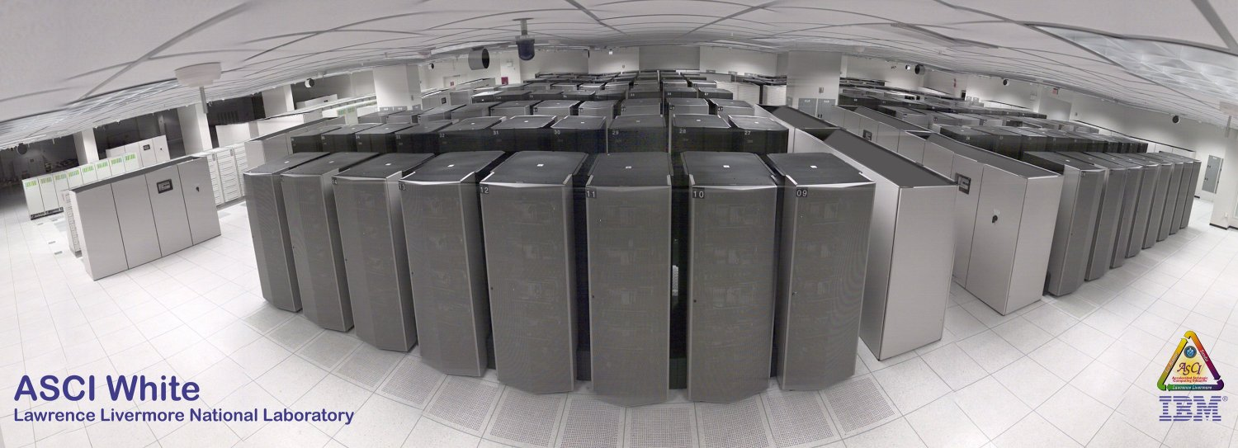
ASCI White (10 teraops/sec)

Slide 25
Seeking Concurrency
Data dependence graphs
Data parallelism
Functional parallelism
Pipelining

Slide 26
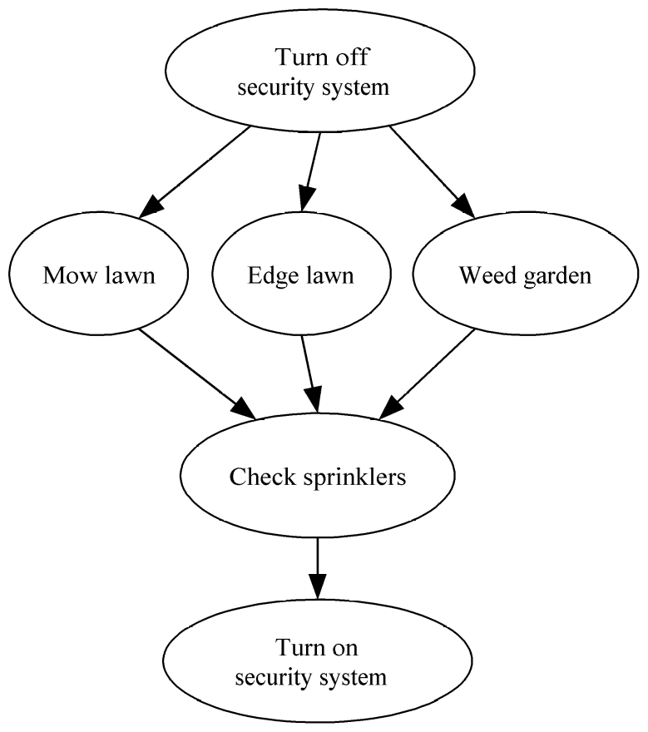
Data Dependence Graph
Directed graph
Vertices = tasks
Edges = dependences

Slide 27
Data Parallelism
Independent tasks apply same operation to different elements of a data set
Okay to perform operations concurrently
for i ← 0 to 99 do
a[i] ← b[i] + c[i]
endfor

Slide 28
Functional Parallelism
Independent tasks apply different operations to different data elements
First and second statements
Third and fourth statements
a ← 2
b ← 3
m ← (a + b) / 2
s ← (a² + b²) / 2
v ← s - m²

Slide 29
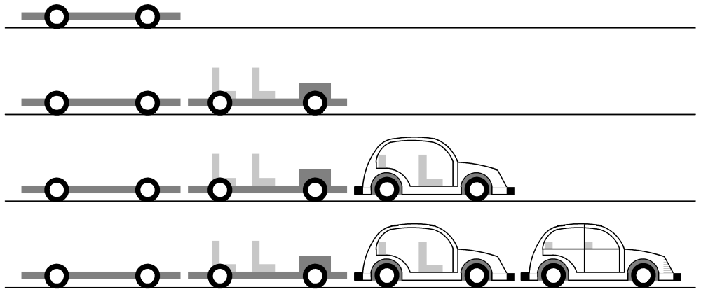
Pipelining
Divide a process into stages
Produce several items simultaneously

Slide 30
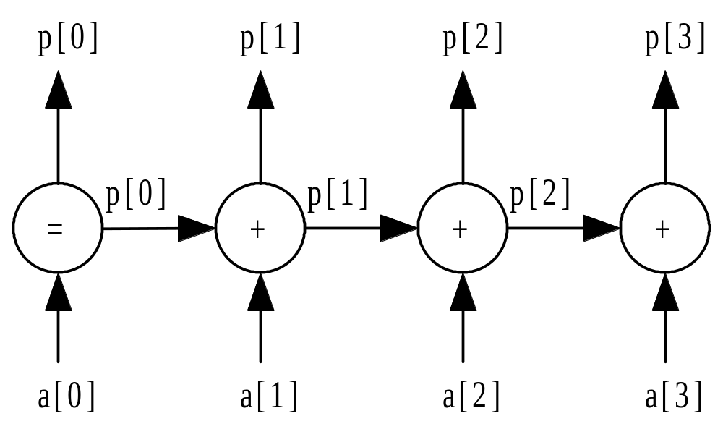
Partial Sums Pipeline

Slide 31
Data Clustering
Data mining = looking for meaningful patterns in large data sets
Data clustering = organizing a data set into clusters of “similar” items
Data clustering can speed retrieval of related items

Slide 32
Document Vectors
Moon
The Geology of Moon Rocks
The Story of Apollo 11
A Biography of Jules Verne
Alice in Wonderland
Rocket

Slide 33
Document Clustering

Slide 34
Clustering Algorithm
Compute document vectors
Choose initial cluster centers
Repeat
  Compute performance function
  Adjust centers
Until function value converges or max iterations have elapsed
Output cluster centers

Slide 35
Data Parallelism Opportunities
Operation being applied to a data set
Examples
  Generating document vectors
  Finding closest center to each vector
  Picking initial values of cluster centers

Slide 36
Functional Parallelism Opportunities
Draw data dependence diagram
Look for sets of nodes such that there are no paths from one node to another

Slide 37
Data Dependence Diagram
Build document vectors
Choose cluster centers
Compute function value
Adjust cluster centers
Output cluster centers

Slide 38
Programming Parallel Computers
Extend compilers: translate sequential programs into parallel programs
Extend languages: add parallel operations
Add parallel language layer on top of sequential language
Define totally new parallel language and compiler system

Slide 39
Strategy 1: Extend Compilers
Parallelizing compiler
  Detect parallelism in sequential program
  Produce parallel executable program
Focus on making Fortran programs parallel

Slide 40
Extend Compilers (cont.)
Advantages
  Can leverage millions of lines of existing serial programs
  Saves time and labor
  Requires no retraining of programmers
  Sequential programming easier than parallel programming

Slide 41
Extend Compilers (cont.)
Disadvantages
  Parallelism may be irretrivably lost when programs written in sequential languages
  Performance of parallelizing compilers on broad range of applications still up in air

Slide 42
Extend Language
Add functions to a sequential language
  Create and terminate processes
  Synchronize processes
  Allow processes to communicate

Slide 43
Extend Language (cont.)
Advantages
  Easiest, quickest, and least expensive
  Allows existing compiler technology to be leveraged
  New libraries can be ready soon after new parallel computers are available

Slide 44
Extend Language (cont.)
Disadvantages
  Lack of compiler support to catch errors
  Easy to write programs that are difficult to debug

Slide 45
Add a Parallel Programming Layer
Lower layer
  Core of computation
  Process manipulates its portion of data to produce its portion of result
Upper layer
  Creation and synchronization of processes
  Partitioning of data among processes
A few research prototypes have been built based on these principles

Slide 46
Create a Parallel Language
Develop a parallel language “from scratch”
  occam is an example
Add parallel constructs to an existing language
  Fortran 90
  High Performance Fortran
  C*

Slide 47
New Parallel Languages (cont.)
Advantages
  Allows programmer to communicate parallelism to compiler
  Improves probability that executable will achieve high performance
Disadvantages
  Requires development of new compilers
  New languages may not become standards
  Programmer resistance

Slide 48
Current Status
Low-level approach is most popular
  Augment existing language with low-level parallel constructs
  MPI and OpenMP are examples
Advantages of low-level approach
  Efficiency
  Portability
Disadvantage: More difficult to program and debug

Slide 49
Summary (1/2)
High performance computing
  U.S. government
  Capital-intensive industries
  Many companies and research labs
Parallel computers
  Commercial systems
  Commodity-based systems

Slide 50
Summary (2/2)
Power of CPUs keeps growing exponentially
Parallel programming environments changing very slowly
Two standards have emerged
  MPI library, for processes that do not share memory
  OpenMP directives, for processes that do share memory

